Slide 1
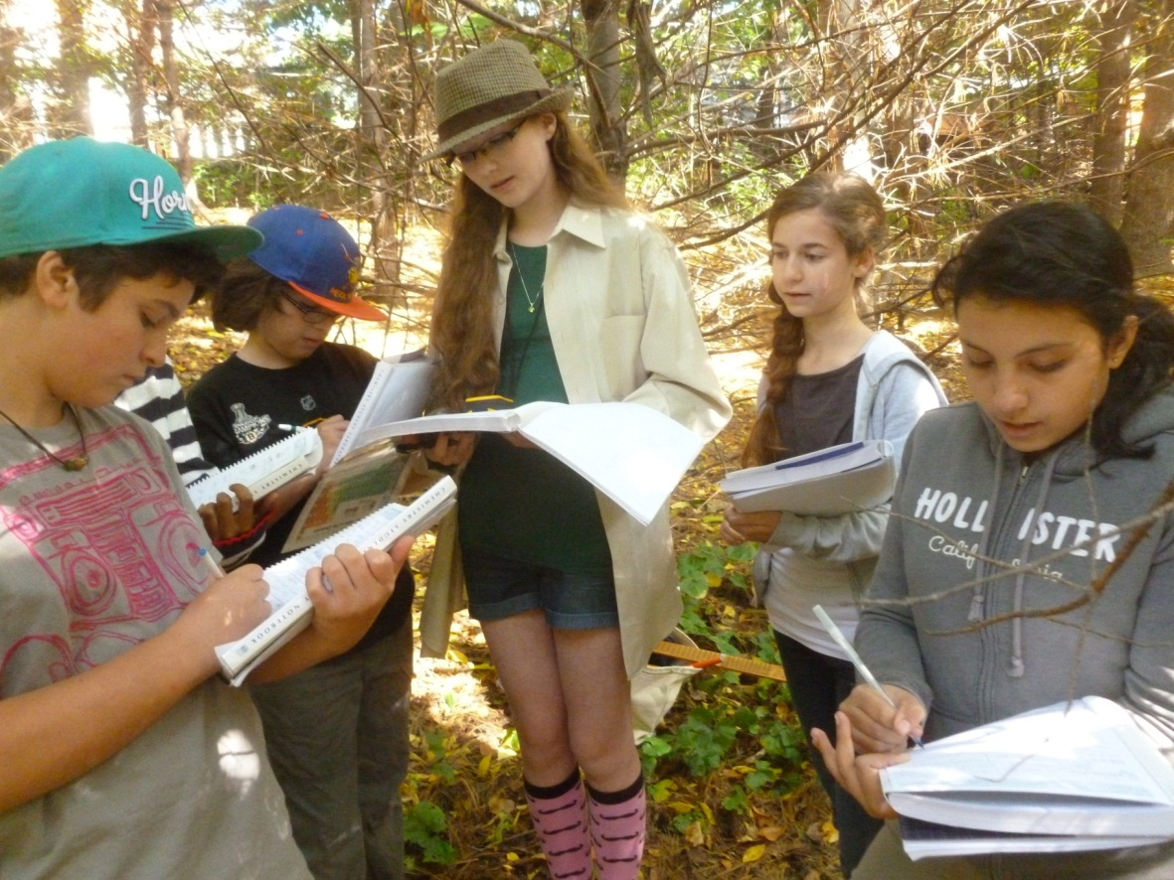
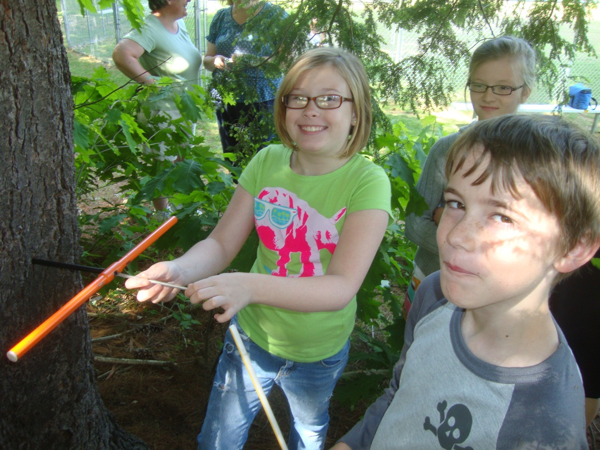
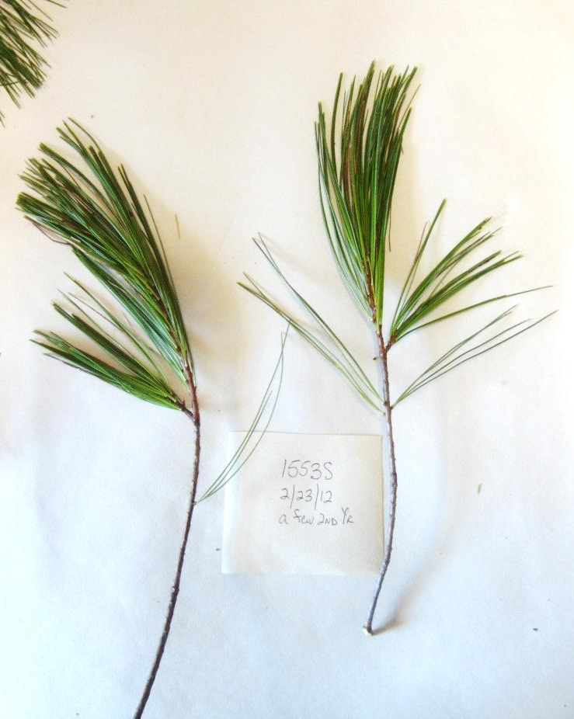
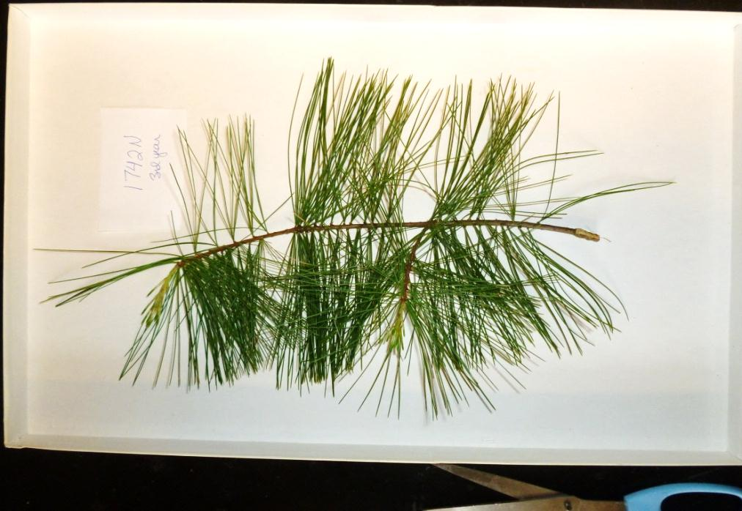
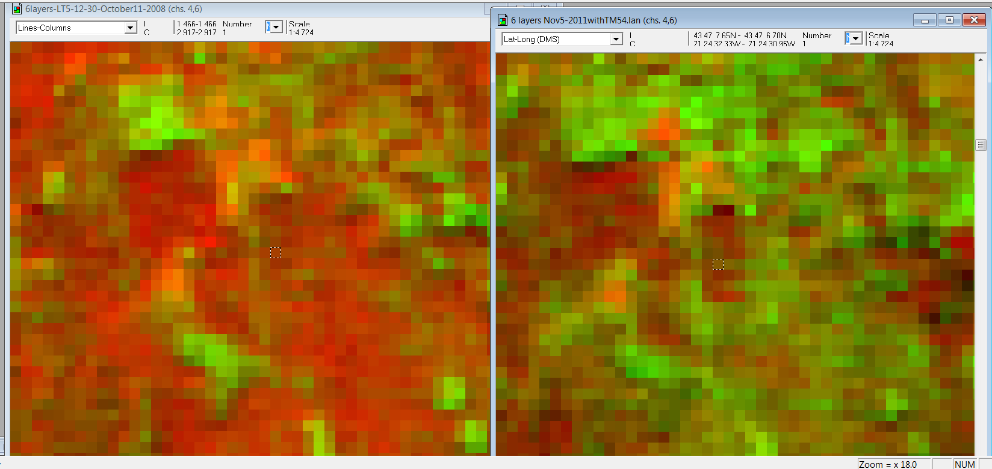
Forest Watch Tracks Discovery with Landsat Martha Carlson, Barrett Rock and Forest Watch Schools University of New Hampshire
Introduction
In 2010, for the first time in 22 years, white pines, Pinus strobus, exhibited a loss of second and third-year needles. As heavy needle cast continued in 2011 and 2012, Forest Watch teachers and students collected evidence of water stress and early senescence in first-year needles, the first such damage documented since the mid-1990s when ozone levels frequently exceeded federal standards.
These discoveries are unique to Forest Watch and its long-term partnership with some 380 teachers in 270 schools across New England and the mid-Atlantic. Students’ careful measurements and regular sampling of more than 2,000 white pines provide Forest Watch with a one-of-a-kind record of forest health.
Forest Watch is comparing Landsat imagery before the June 2010 first needle cast with Landsat 2011 images. We want to locate stressed pines and quantify the range of the damage. A map of needle cast damage might even help to identify the causal agent. The project will test both Landsat and Forest Watch: Can we use this satellite imagery to identify initial stress, subtle changes in the Thematic Mapper Band 5/4 ratio?
Background
Forest Watch schools have used Landsat imagery since 1992. Students and teachers see their schools and white pine study sites from space. They learn to manipulate Landsat bands using MultiSpec, an interpretive software created by Purdue University. Landsat explorations give students their first visual adventures with “seeing” light. When remote sensing connects us with “my school” and “our white pines”, the power of 21st century technology excites students to learn more.
Where Is My School?
First lessons with Landsat are Look And See. How beautiful our corner of Earth looks from 500 miles high! New Hampshire students find the Atlantic Ocean and then Lake Winnispesaukee. Look how the Merrimack River curves into Massachusetts. In one path and row, Landsat can see from Boston to Sebago Lake. In one scene’s 56 million pixels, we see how big Earth is.
Geography Comes to My School
Zooming in on a Landsat 12-30 image, Sandwich Central students, Sandwich, NH, discover their own Bearcamp Valley. The Ossipee Mountains, a familiar horizon in the east, is a surprising circle, a rare ring dyke. Familiar coves on Squam Lake now echo mountain ravines just to the west. As students learn to use MultiSpec, seasonal differences turn the Sandwich Range red-orange a November 2011 scene at right, as high elevation birch and wetland marshes lose summer foliage.
Figures 4: Forest Watch students learn to build histograms of their own biological measures of pine needles and tree height and diameter. With Landsat, they discover that histograms can help them to compare scenes. In Figure 4.A, a histogram for a site selected by latitude and longitude produces a plot of reflectance for each band with reflectance data. The data, saved to an Excel file, helps build mean reflectances comparing a 2008 image with a 2011 image, Figure 4.B. The image comparisons show little difference between pines and deciduous trees in mid-October, Figure 4.C. But by November, Figure 4.D, the pines leap out with near infrared reflectance, the first step in mapping the pines’ location. Both 4C and 4D use just two color channels to depict difference in infrared Band 4, in the red channel, and a constructed TM5/4 ratio, in the green channel.
A Challenging Quest
Forest Watch is confident that the information about New England’s white pines lies nascent in Landsat images—if only we can find the right combination of scenes. Landsat 8 will undoubtedly help Forest Watch to pioneer early detection of stress in one of New England’s most valued timber species.
Figures 3: A comparison of two images shows dramatic seasonal differences between October 11 foliage, 2008, at left, and November 5, 2011, foliage at right. Both images use a 5/4,4, 3 selection placing a TM 5/4 water content ratio in the red channel, Near Infrared in the green channel, and visible red light in the blue channel.
Greatest moisture content
Figures 1: At left, long-term spectral data from white pine samples submitted each year since 1992 detail change in the TM 5/4 ratio, an indicator of water content in plant foliage. Above, white pine samples from a northern New Hampshire school show loss of all third-year needles and almost all second-year needles. At right, a sample from a southern Connecticut school shows dense foliage for three years.
A
C
D
Figures 2: Above, Path 12, Row 30, a Landsat 5 image taken on September 27, 2000, displayed with a 5/4,4,3 color selection, shows New England from Boston at lower right to Lake Winnipesaukee at upper left. Landsat activities teach students to zoom in close to identify urban areas, wetlands, forests, roads, rivers, and school play yards.
At right, a clip of Colebrook, New Hampshire, displayed in a 4,3,2 color selection introduces students and their teacher to the bright reflectance of invisible near infrared light and the joy of finding their school, their park, their river.

